Slide 1
Regression Analysis

Slide 2
Agenda
What is Regression
Assumptions of Linear Regression
How to avoid overfitting - Bias and variance Tradeoff
Ridge and Lasso Regression
Regression Evaluation Matrix

Slide 3
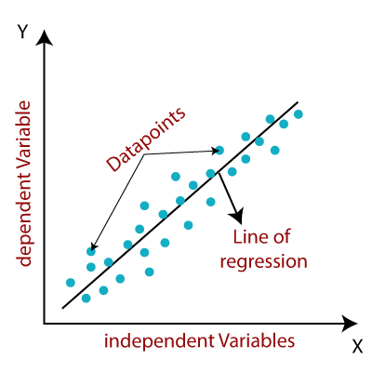
Regression Intuition
Regression — can be thought of as “relationship” between any two things
Simple linear regression: Y = a + bX + u
Where:
Y = the variable that you are trying to predict (dependent variable)
X = the variable that you are using to predict Y (independent variable)
a = the intercept
b = the slope
u = the regression residual

Slide 4
Multivariate Regression
Multiple linear regression:
Y = a + b1X1 + b2X2 + b3X3 + ... + btXt + u
If more than one independent variable is used to predict the value of a numerical dependent variable, then such a Linear Regression algorithm is called Multiple Linear Regression
b1, b2, b3,.., bt are coefficient of variables X1, X2, X3,.., Xt also can be considered as a slopes
b1 indicates by what values Y will change if we change X1 by one unit keeping all other variables constant

Slide 5
Assumptions of Linear Regression
Linear relationship: There exists a linear relationship between the independent variable, x, and the dependent variable, y
Independence: The residuals are independent. In particular, there is no correlation between consecutive residuals in time series data
Homoscedasticity: The residuals have constant variance at every level of x
Normality: The residuals of the model are normally distributed
No or little Multicollinearity: No correlation between independent variables

Slide 6
Bias Variance Tradeoff
Bias are the simplifying assumptions made by a model to make the target function easier to learn
Variance is the amount that the estimate of the target function will change if different training data was used
The goal of any supervised machine learning algorithm is to achieve low bias and low variance. In turn the algorithm should achieve good prediction performance
There is no escaping the relationship between bias and variance in machine learning
Increasing the bias will decrease the variance
Increasing the variance will decrease the bias

Slide 7
Ridge and Lasso Regression
Ridge and Lasso regression are some of the simple techniques to reduce model complexity and prevent overfitting which may result from simple linear regression
Estimating the coefficients of multiple-regression models in scenarios where linearly independent variables are highly correlated
Ridge Regression : In ridge regression, the cost function is altered by adding a penalty equivalent to square of the magnitude of the coefficients.
Lasso Regression: Lasso regression is a type of linear regression that uses shrinkage. Shrinkage is where data values are shrunk towards a central point, like the mean

Slide 8
Regression Evaluation
R-Squared:
R2 is a statistical measure of fit that indicates how much variation of a dependent variable is explained by the independent variable in a regression model
R2 is generally interpreted as the percentage of a independent variable movements that can be explained by movements in a dependent variable
A value of 1 indicates a model that perfectly predicts values in the target field. A value that is less than or equal to 0 indicates a model that has no predictive value.
Adjusted R2 is a corrected goodness-of-fit (model accuracy) measure for linear models
R2 tends to optimistically estimate the fit of the linear regression. It always increases as the number of effects are included in the model. Adjusted R2 attempts to correct for this overestimation. Adjusted R2 might decrease if a specific effect does not improve the model.
Adjusted R2 is always less than or equal to R2

Slide 9
Regression Evaluation (Continued…)
RMSE:
Root Mean Square Error (RMSE) is the standard deviation of the residuals (prediction errors). Residuals are a measure of how far from the regression line data points are; RMSE is a measure of how spread out these residuals are.
In other words, it tells you how concentrated the data is around the line of best fit.
MAPE:
The mean absolute percentage error (MAPE) is a measure of how accurate a forecast system is.
It measures this accuracy as a percentage, and can be calculated as the average absolute percent error for each time period minus actual values divided by actual values.

